Slide 1
Beach Boys, Surf Music, and Hot Rods

Slide 2
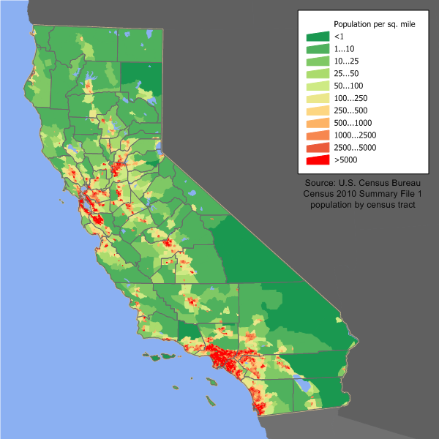
1940 pop.: 7 million
1950 pop.: 10.6 million
1962 pop. 17 million, pop. (expanding 1700 per day)

Slide 3
California, another nation?
Massive, sprawling, wealthy
Resource rich: gold, oil, minerals, agriculture, tourism
Distant from the eastern seaboard
Beaches
Disneyland, opened July 1955
Hollywood, center of movie-making.
Silicon Valley: Western Electric, Raytheon, Remington Rand, Zenith, and Motorola
Toy maker Mattel (Hawthorne, CA): Barbie, Disney toys, etc.

Slide 4
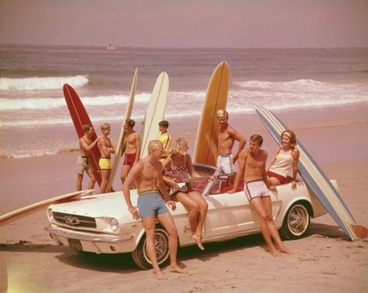
Surf culture, 1950s-1960s
Boards, sticks, woodies, polys
Soup, big guns, hairy
Hot dogging,
Bunnies, Barbies
Gremlins, kooks

Slide 5
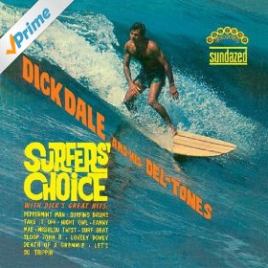
Surf music: Miserlou?
Richard Anthony Monsour (b. 1937) from Boston and Quincy, Mass.
After grade 11, moved to El Segundo, learned to play piano, ukulele, guitar, trumpet, tarabaki, and drums.
Learned to surf, and then made music to match.
Leo Fender: guitars and amps (first 100-watt amp)
Michalis Patrinos (from Izmir), “Miserlou,” 1930:
https://www.youtube.com/watch?v=1Qd2Nb-oh4I
Dick Dale and the Del-Tones, “Miserlou,” 1962:
https://www.youtube.com/watch?v=mKpsuGMeqHI
Beach Party (1963 film):
https://www.youtube.com/watch?v=tm_G_DCJMmY
Single-note staccato playing influenced, Hendrix, emergence of Heavy Metal

Slide 6
Jan and Dean
William Jan Berry (1941-2004): father was Howard Hughes’ project manager for the “Spruce Goose”. Grew up in Bel Air.
Dean Ormsby Torrence (b. 1940): father sales manager for Wilshire Oil.
Went to the same Junior and High School, played football and sang in the locker room.
Had a hit in 1959 with “Baby Talk”, got to number 10.
Brian Wilson gave them a hit in 1963 with “Surf City,” first surf song to top the Hot 100: https://www.youtube.com/watch?v=ERrwjR4ZlfI
They had 16 top 40 hits, and 26 songs making the top 100 from 1958-1966.
12 April 1966: Jan crashed his Corvette into a parked truck (brain damage, partially paralyzed).

Slide 7
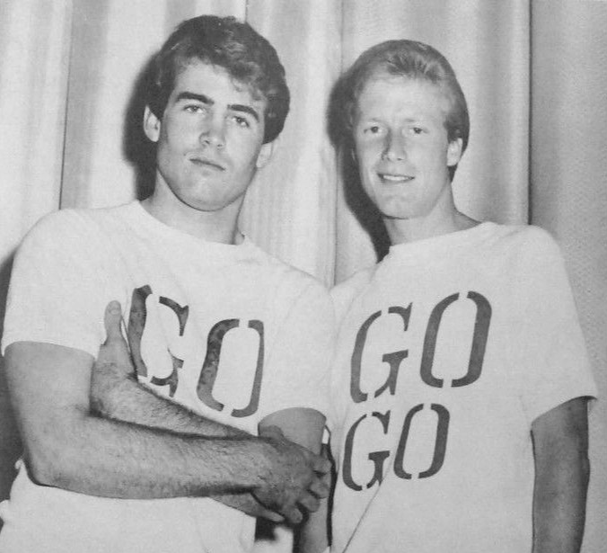
Jan and Dean, 1964

Slide 8
The Beach Boys, 1961-present
Hawthorne, CA
Brothers Brian, Dennis (the only surfer), and Carl Wilson, their cousin Mike Love, and their friend Al Jardine started a garage band, managed by father Murry Wilson.
Brian got a reel-to-reel tape recorder for his 16th birthday.
First band: “Pendletones,” but first recording became The Beach Boys (Russ Regan of Era Records, later president of 20th-Century Fox).
First song, “Surfin’”, 1961
Jazz, R&B, Doo-wop influences
Many others followed: most famous was “Surfin USA”: [link]
Music of Chuck Berry’s “Sweet Little Sixteen” (Jan. 1958): [link]

Slide 9
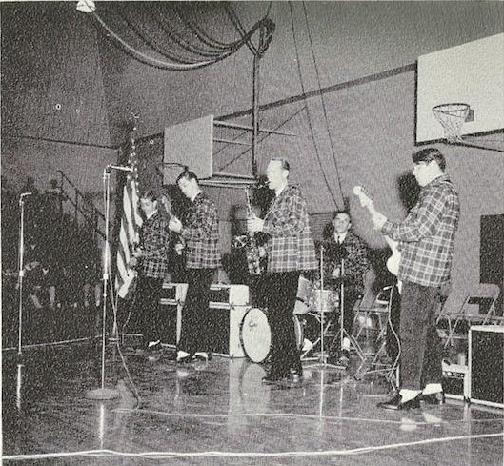
The Beach Boys (Pendletones) in Pendletons, 1963
Notes:
Image source: https://commons.wikimedia.org/wiki/File:Beach_Boys_1963.jpg

Slide 10
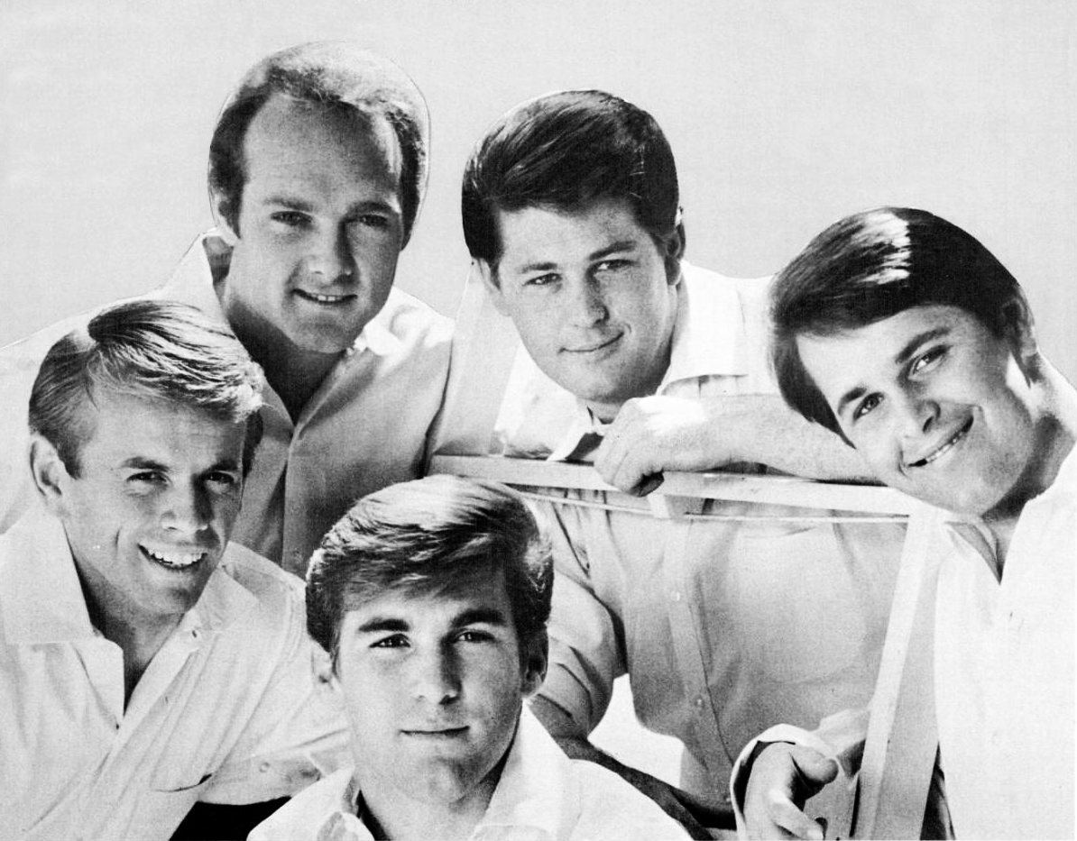
The Beach Boys, 1965

Slide 11
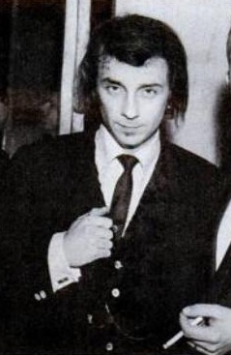
Phil Spector, 1939 to present
Born in the Bronx in 1939.
1958: co-founded The Teddy Bears, lead guitarist.
Wrote and performed “To know him is to love him.” [link]
1960 co-founded Philles Records with Lester Sill, youngest US label owner at the time.
Gifted at finding talent and producing it: “Wall of Sound”
The Crystals, “Da Doo Ron Ron,” [link]
The Ronettes, “Be My Baby,” [link]
Control freak, see Ronnie Spector’s autobiography.

Slide 12
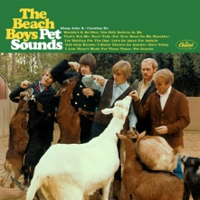
“Pet Sounds”, 1966
Brian Wilson’s project [link]
The Beatles’ “Rubber Soul” (Dec 1965)
Worked with lyricist Tony Asher.
Stopped touring.
Focused on recording (marijuana).
First rock concept album, rock was not only for dancing (earphones in the dark).
Initially, not well received in USA (peaked at no. 10), though embraced in the UK (no. 2).
Single: “Wouldn’t it be nice”
Not very popular then, but very influential.
By 2000, sold over two million copies.

Slide 13
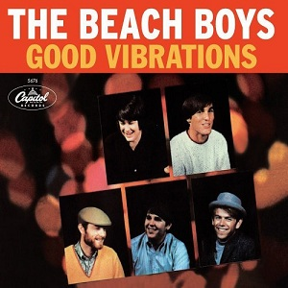
Good Vibrations, October 1966
Wilson wrote music to sound like cosmic vibrations.
90 hours of tape used in recording (perfectionist)
Mike Love wrote words to go with emerging Flower Power / Hippie Movement.
Released as a single, no album.
Soon dubbed a “pocket symphony.”
Helped spawn greater pop experimentation, psychedelic rock, and progressive rock.
Influenced such songs as “A Day in the life” and “Bohemian Rhapsody.”
Link: https://www.youtube.com/watch?v=5IYJtdtr678

